Slide 1

Flash – Local Express
PROJ-611-001 Adoption of Cloud Computing and Blockchain Technology in the Industry
Instructor
Ms. Mayra Samaniego MSc. Ph.D.
Students
Hai Nam Nguyen – nguyen0465@saskpolytech.ca
Xuan Hieu Nguyen – nguyen8191@saskpolytech.ca
Cong Chi Tai Nguyen - nguyen6169@saskpolytech.ca

Slide 2
Agenda
Problem Definition
The Importance of Solution
Architecture
Project Budget
Front-end
Demo
Benefits of Solution

Slide 3

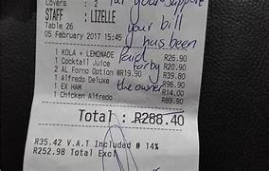

Problem Definition
Processing order manually​
Lack of communication (driver, customer, restaurant)​
Revenue report
Notes:
Nowadays, we have many application to order food like Doordash , Skipthedishes. But still have number of customer who will contact directly by phone or email to order. Some restaurant will reserve driver to deliver food but they have faced some problems:
- Process order manually : when customer call, they write down on paper bill and use this bill to transfer customer’s requirement to kitchen and assign delivery batch for driver. Then there are a lot of issue like: loss bill, handwriting issue. Moreover, lack of communication is big challenge , restaurant and customer don’t know about order’s status, driver cannot provide evidence for order completion. Consequence, order can be cancelled and impact on restaurant’s reputation. Last thing , they don’t have any dashboard for revenue report at the end of day.

Slide 4
The importance of solution
Increase quality of customer services.
Decrease conflicts during delivery stage.
Human mistakes prevention.
Notes:
Our expectation is increasing quality of customer services, limit conflict and human mistakes in delivery stage.

Slide 5
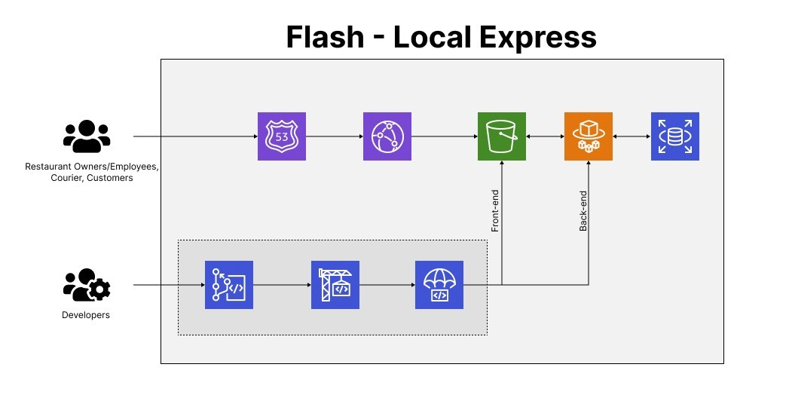
Architecture
Notes:
Backend:
Build a Django project, rest api to communicate w front end,
try to adopt as much as possible aws for this practical project and apply best practice
AWS: Personal Account, utilizing codecommit for backend repository
codebuild for build docker image and push the image to ECR repository
codedeploy the ecr image to ECS then initial a new task
ECS: Fargate instance, ec2 load balancer
AWS: Learning Lab, host RDS Postgresql DB
About our front-end, we also use codepipeline from AWS for the

Slide 6
Budget
# | Service Name | February | March | April | May
1 | Domain .com | $12.00 | $0.00 | $0.00 | $0.00
2 | Front-end Theme | $32.00 | $0.00 | $0.00 | $0.00
3 | S3 Standard | $1.00 | $1.00 | $1.00 | $1.00
4 | Amazon RDS for PostgreSQL | $13.43 | $13.43 | $13.43 | $13.43
5 | AWS Fargate | $8.38 | $8.38 | $8.38 | $8.38
Cost per month |  | $66.81 | $22.81 | $22.81 | $22.81
Cost in 4 months |  | $135.24
Source: https://calculator.aws/#/
Notes:
Following the architecture above, we have defined the list of services that need to be used for the whole time of the project. The list of it including: a domain, the front-end theme which are pay 1 time, Amazon Web Services such as Simple Storage Service as know as S3 for our front-end hosting, Relational Database Service for PostgreSQL for our database, and Fargate for the back-end.
These services cost us $135 dollars from February to May as estimated in the slide. The half of it was sponsored by our teammate, Tai Nguyen, the one who received a scholarship from our school.

Slide 7
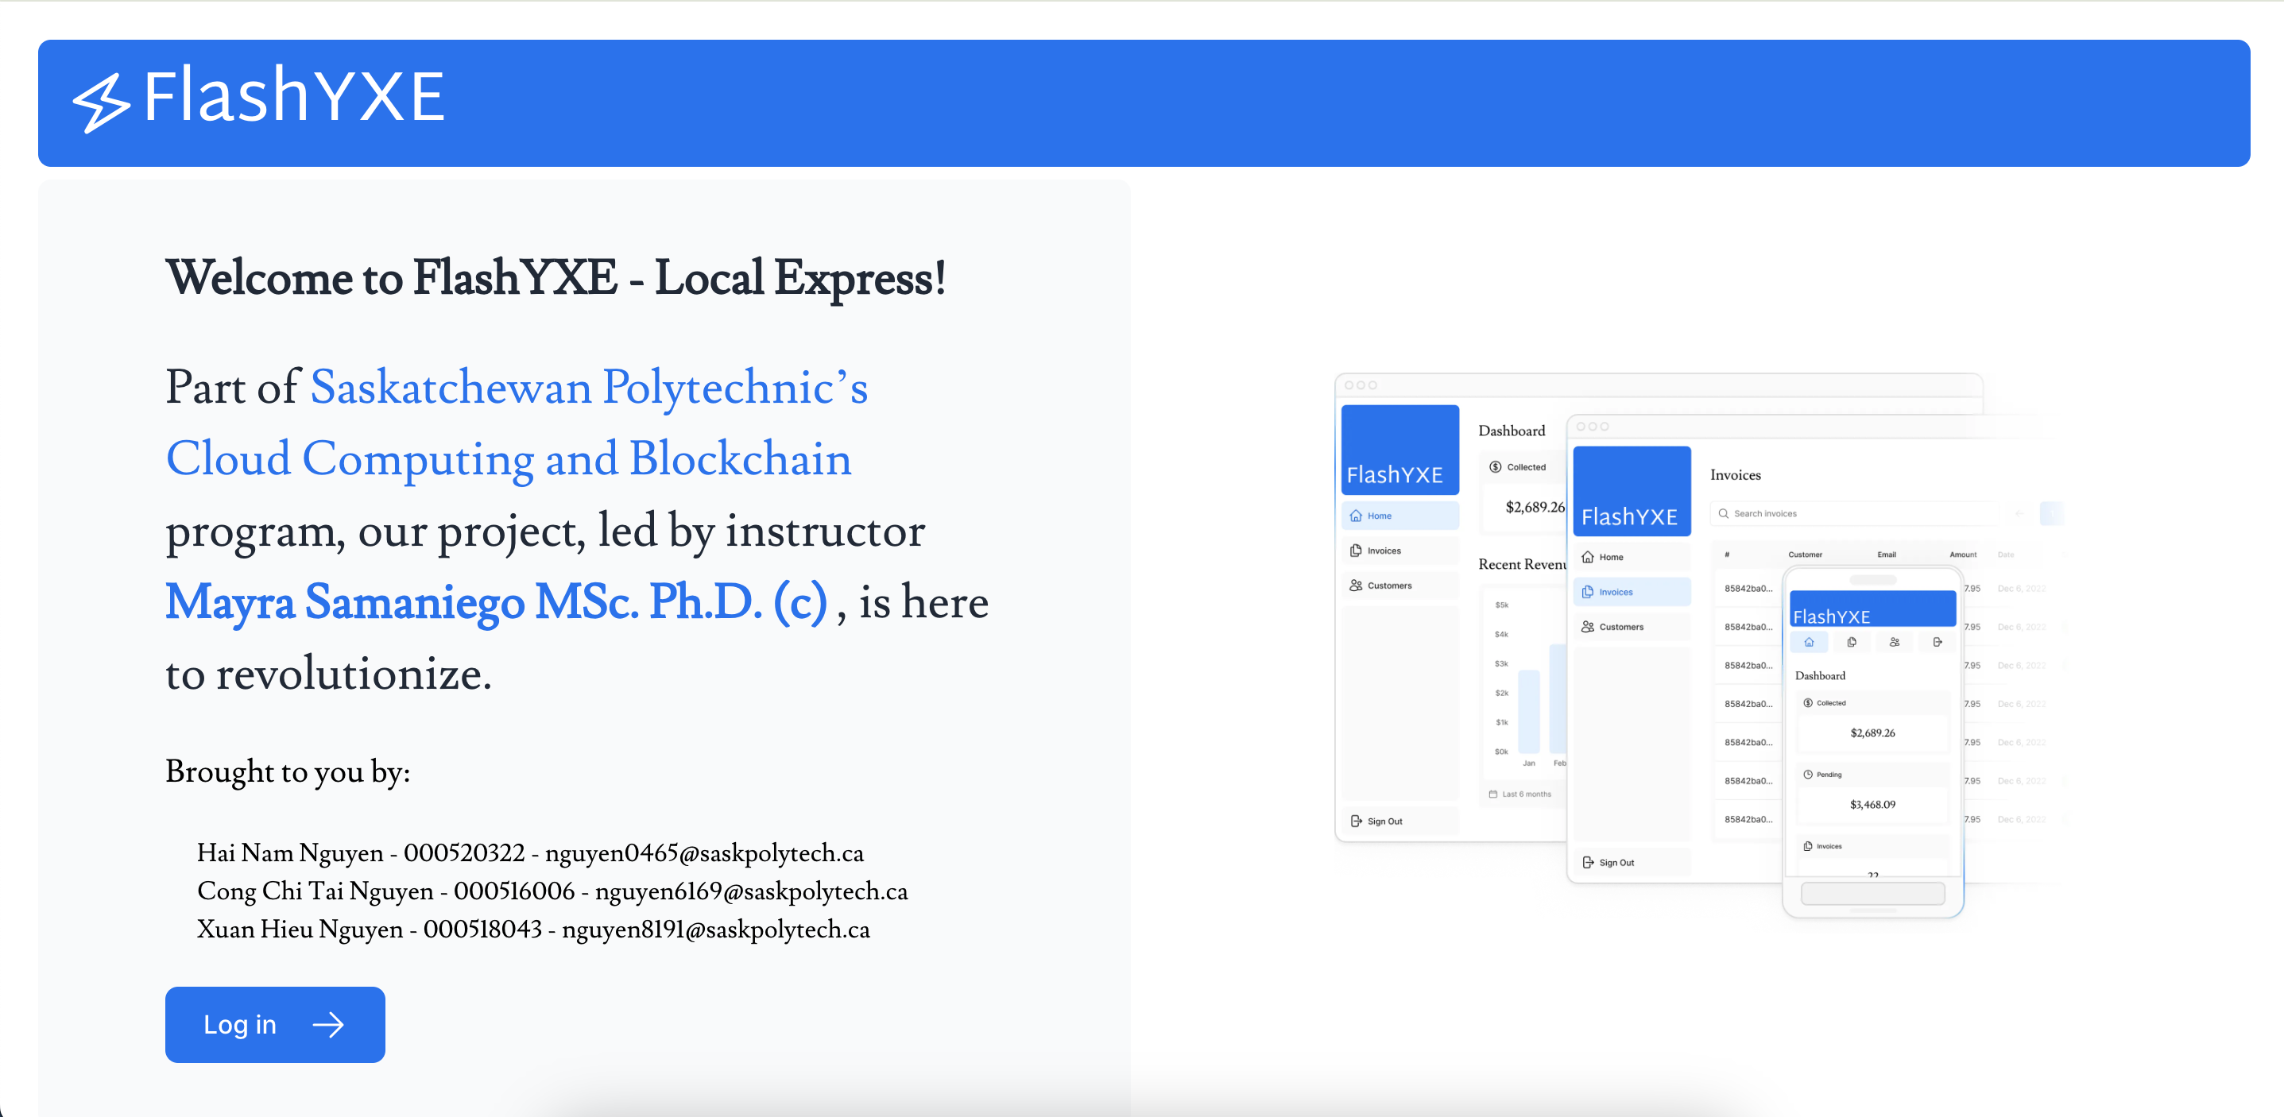
Front-end – Home Page
Notes:
We have designed the front-end customized after buy a theme, this is our Home Page for it. From this homepage, you could click to the login and putting your credentials to the login page and the whole process will be demo by Tai after these slides

Slide 8
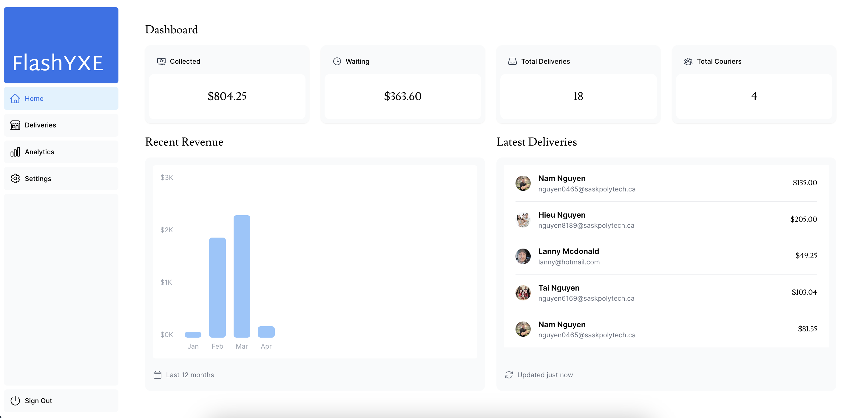
Front-end – Dashboard Page
Notes:
On the Dashboard Page, you could see everything on it, this is the Owner/Restaurant Manager can see how much they earned, how many deliveries, history of the Revenue and what is the status of delivery at the moment. The process of our application and resturant will be showed now by Tai Nguyen, I'll hand this back to him.

Slide 9
Demo
FlashYXE – Home Page
Notes:
Thanks Mayra and Yong for provide learning lab
Thanks Thien restaurant and Lanny McDonald for support us make this video demo
In demo we show practical process partner with real situation and how our application operating
We also present the dashboard for restaurant owner and delivery

Slide 10
Benefits
Increase revenue of restaurant.
Eliminate manual process.
Lighten workload of employee.
Notes:
Resolve the mis-communication between restaurant-driver-customer in case of order food via website, phone call channels
Adopt cloud computing to enhance manual work to auto process for end-user for daily operation and report summary
Free manual tasks and improve performance for restaurant staffs and give more income for delivery

Slide 11

THANK YOU FOR YOUR TIME
Q&A

Slide 12
Flash – Local Express
PROJ-611-001 Adoption of Cloud Computing and Blockchain Technology in the Industry
Instructor
Ms. Mayra Samaniego MSc. Ph.D.
Students
Hai Nam Nguyen – nguyen0465@saskpolytech.ca
Xuan Hieu Nguyen – nguyen8191@saskpolytech.ca
Cong Chi Tai Nguyen - nguyen6169@saskpolytech.ca

